Slide 1
2015 Conaway Conference
Consultant Inspection & Prequalification
Lyle Flower Administrator
Office of Consultant Services

Slide 2
History of Prequalification
Firms were Prequalified 20 years ago
Judged to be Ineffective and Ended
ODOT began requiring resumes in LoIs

Slide 3
History of Prequalification
Prequalification based on HT Series Training evaluated 7-8 Years ago
Not enough capacity to train consultants

Slide 4
History of Prequalification
Consultant performance on ODOT contracts has generally been good
Performance on LPA Local Let contracts has been inconsistent
Contract administration and inspection has been found deficient in many instances

Slide 5
History of Prequalification
January, 2012
Division of Construction Administration determined that prequalification should be considered

Slide 6
History of Prequalification
February, 2012 - ODOT/ACEC Committee Initiated
September, 2012 - Requirements posted to website for comments

Slide 7
History of Prequalification
Requirements published in March, 2013
Full Implementation for selection in September, 2014
Prequalification required for ODOT and Federally funded LPA projects

Slide 8
History of Prequalification
Current Implementation Status
Still monitoring the numbers of prequalified individuals
To date prequalification has been a selection factor and not a requirement to work on a jobsite
Full requirements will be implemented in the near future as numbers increase

Slide 9
History of Prequalification
Objective was uniform professional standard for administration of both ODOT and LPA construction contracts

Slide 10
Prequalification Categories
Individuals prequalified in seven categories
Firms prequalified in one category

Slide 11
Prequalification Categories
Inspection
Project Inspector
Project Inspector - Structures
Coatings Inspector
Traffic and Electrical Inspector
Soils and Aggregate Inspector
Contract Administration
Construction Engineer 1
Construction Engineer 2
Construction Management Firm

Slide 12
Certifications
Certifications Required:
National Institute for Certification in Engineering Technologies (NICET)
National Association of Corrosion Engineers (NACE)
Society for Protective Coatings (SSPC)
International Municipal Signal association (IMSA)
ACI Level 1
Flexible Pavement Test
Ohio Aggregate Level 1
ODOT Work Type 26 Structural Steel Painting
ODOT Work Type 57 Sealing of Concrete Surfaces

Slide 13
Current Prequalification by Category
Prequalification Category | Number Prequalified March, 2015
Project Inspector | 101
Project Inspector (Structures) | 25
Coatings Inspector | 44
Traffic and Electrical Inspector | 3
Soils and Aggregate Inspector | 80
Construction Engineer Level 1 | 33
Construction Engineer Level 2 | 139
Construction Management Firm | 45

Slide 14
Seven Year History of ODOT CI Contracts

Slide 15
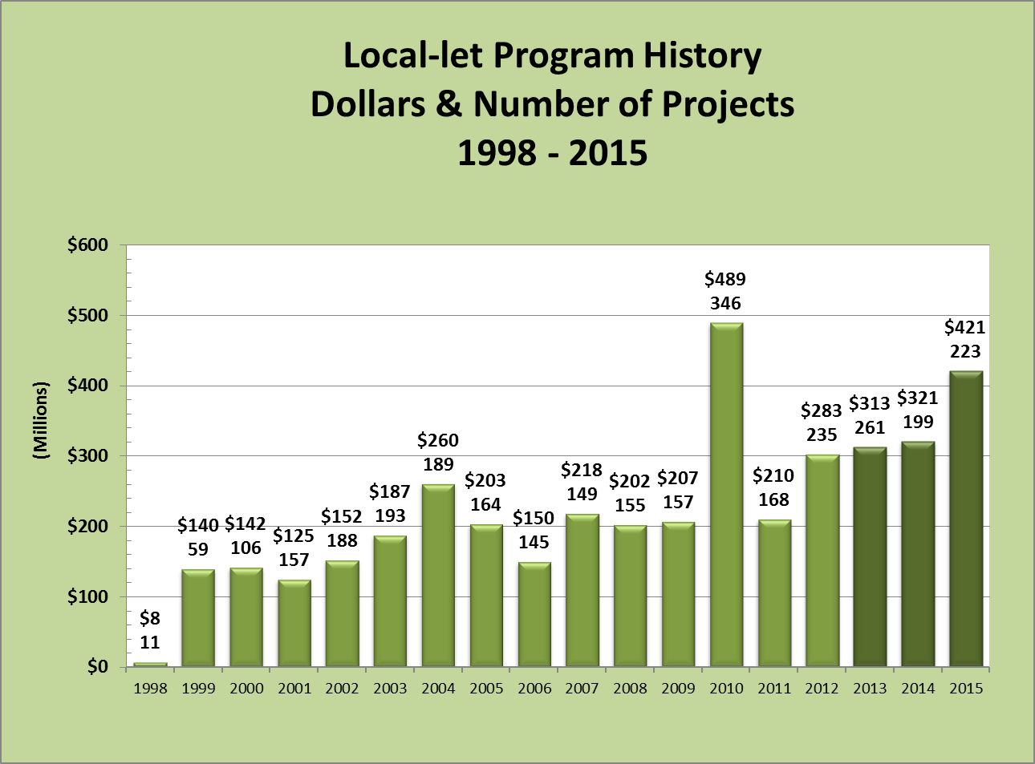
Local Let History

Slide 16
Future Use of Consultants
Trend in number of contracts and dollars is Upward for both ODOT and Local Let Projects

Slide 17
Types of Services
In the past, ODOT contracts have been mostly construction inspection – project inspector level personnel managed by ODOT
ODOT is now using construction administration contracts to a limited extent
LPA contracts may include inspection and administration

Slide 18
Revised Scope of Services
Scope of Services Documents for both ODOT and Local Let
Revised to incorporate ODOT’s Construction Inspection Manual of Procedures
Division 100 addresses Construction Contract Administration
Remainder addresses Inspection Procedures

Slide 19
Consultant Prequalification
Questions?
Comments?
Panel Discussion

